Slide 1

Elastic Search Essentials

Slide 2
What is Elastic search

Slide 3
Elastic search
Popular NoSQL distributed database
It is document-based
It does not require schema
It does not require tables
It does not use popular query language
Started in 2010

Slide 4
Using Elastic search
Why Elastic Search?
Speed – index millions of documents
Relevancy – apply scoring to documents
Statistics – see trends in the data
Where to use Elastic Search?
Fast search among records
Log analytics
Documents with many different attributes with unpredictable schema

Slide 5
Elastic search Top use cases
Logging & Log Analysis
Combing Public Data
Metrics
Full-Text Search
Data Visualization (with Kibana)

Slide 6
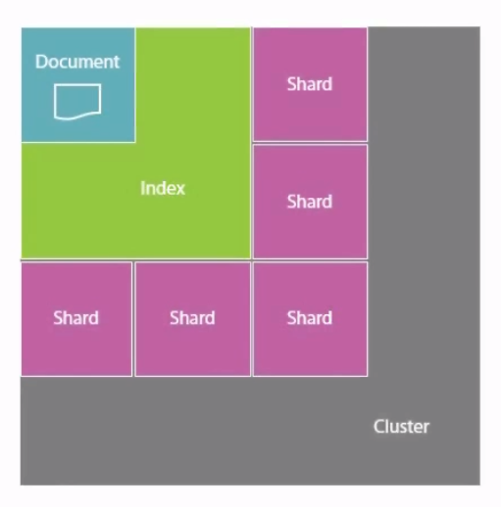
Elastic search concepts
Documents – instead of tables
They are schema less
Documents are stored in indexes
Indexes are stored across multiple shards
Logical way to separate the data into multiple chunks
These chunks can be stored in separate servers
Shards are stored in one or more nodes
These nodes are easily scalable

Slide 7
Installing elastic search
Go to https://www.elastic.co/downloads/elasticsearch and download it
Installation guide: https://www.elastic.co/guide/en/elasticsearch /reference/current/install-elasticsearch.html
Or use a container
Go to the installation folder it configure it
You need to edit the elasticsearch.yml file in the config folder
Uncomment and edit the cluster name
Uncomment and edit the node name
Turn Elastic Search on
Go to http://localhost:9200 to validate Elastic Search is up and running

Slide 8
elastic search Plugins
Elastic Search has a rich plugin ecosystem
Install Kibana:
More information here: https://www.elastic.co/downloads/kibana
Web-based overview and access
After installation – go to http://localhost:5601/app/dev_tools
You can use a Docker image, if you are using containers

Slide 9
Data types & index options

Slide 10
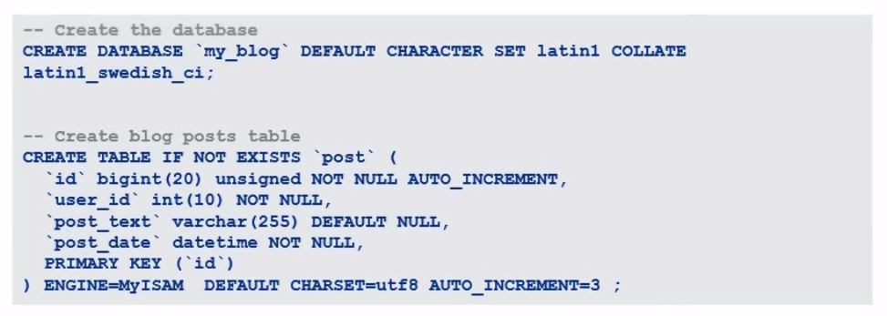
Elastic search Schemas
Consider the typical SQL database:

Slide 11
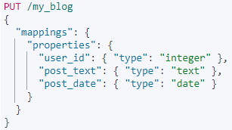
Elastic search Schemas
Here it is translated to Elastic Search schemas:

Slide 12
Using Elastic search
Explaining the terms:
Index – “my_blog” in the URL – we want to create it
Mappings – instead of the word “schema”
Type – instead of a table – we define the schema
Properties – these are like the columns in a typical database
Each property has a type – integer, string, etc.
There is no “id” field, as it is generated automatically

Slide 13
Elastic search commands
To see all indexes:
To create an index:
GET /_cat/indices
PUT /my_blog
{
"mappings": {
"properties": {
"post_text": { "type": "text" }
}
}
}

Slide 14
Elastic search commands
To see an index schema:
Insert a document:
Basic search for documents:
GET my_blog/_mapping
POST my_blog/_doc
{
"post_text": "Hello from Code It Up!"
}
# POST my_blog/_doc/1 for custom ID system
GET my_blog/_search
GET my_blog/_doc/{id}
GET my_blog/_search?q=post_text:awesome

Slide 15
Elastic search data types
Text:
Most common type, like varchar in SQL
Use it to store any collection of characters
Boolean - "true" or "false"
Numbers – "float", "double", "short", "long", "integer", etc. (like in Java)
Dates – stored in UTC by default
Binary – image or blob data, stored in base64 strings
Not indexed by default

Slide 16
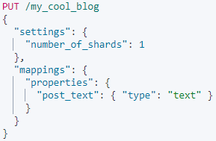
Elastic search settings

Slide 17
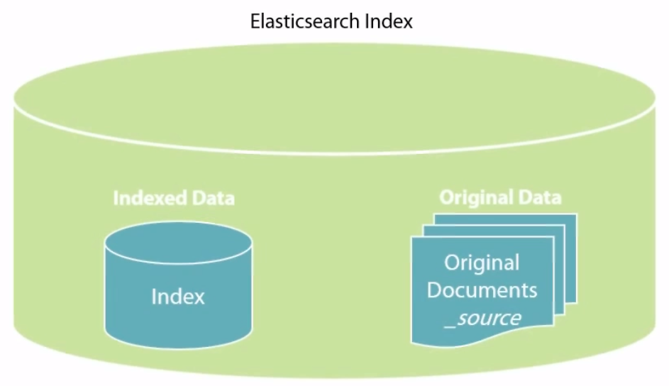
Elastic search Default Data storage

Slide 18
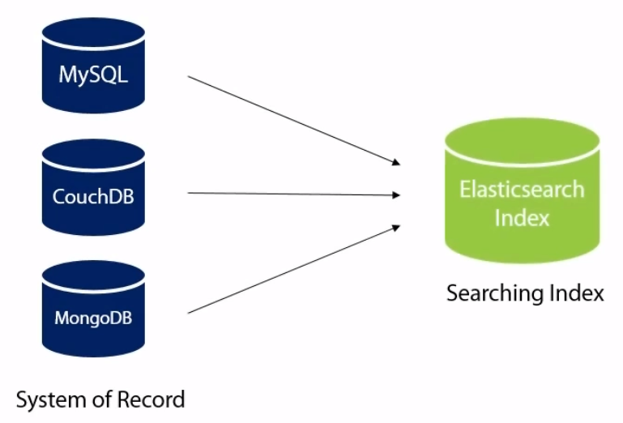
Elastic search Typical Data storage

Slide 19
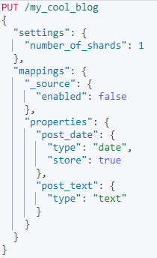
Indexing data without storing it

Slide 20
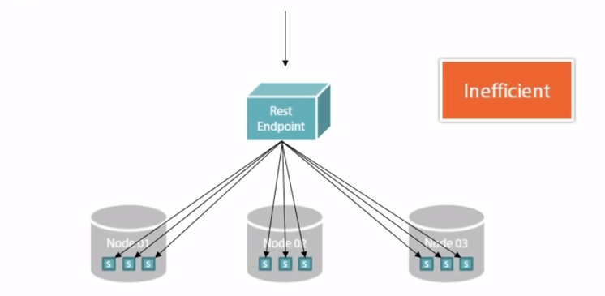
Elastic Search ROUTING

Slide 21
Elastic Search Routing
By default, if you use sharding, Elastic search will separate the documents by their ID
You may override that to optimize the performance of future queries
For example, you may tell Elastic Search to store the data for a single user in a single shard
This way queries for this specific user will be as fast as possible
More information available here:
https://www.elastic.co/guide/en/elasticsearch /reference/current/mapping-routing-field.html

Slide 22
Querying and analysis

Slide 23
Elastic Search DSL
Elastic Search has its own Domain Specific Language (DSL)
Results are returned sorted by score (relevance)
Instead of:
You can write it:
GET my_blog/_search?q=post_text:awesome
GET my_blog/_search
{
"query": {
"match": { "post_text": "cat" }
}
}

Slide 24
Elastic Search DSL
"match" search for at least one word in the phrase
For example, "cute cats" will match "cats are cool"
"match_phrase" will match the exact sequence of words
Having more predictable results
"highlight" will return highlighted HTML with emphasized matches
"aggs" are very powerful aggregations
More information here: https://www.elastic.co/guide/en/elasticsearch /reference/current/search-aggregations.html

Slide 25
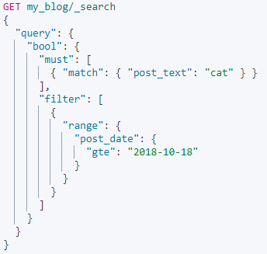
Elastic Search Filters

Slide 26
How elastic search analyses texts
Elastic Search tokenizes each string and stores in which document it appears
It uses analyzers to convert these strings to tokens (terms)
Character filter – removes HTML, converts "1" to "one", etc.
Tokenizers – break the string by whitespace, period, comma, etc.
Token filter – removes words like "and" or "the"
There are a lot of built-in analyzers
Standard – general purpose analyzer
Whitespace – breaks up by whitespace only, useful for computer code or logs
Simple – break up by everything that is not a number
Unanalyzed – it will be inserted as is

Slide 27
Working with .net

Slide 28
ANY QUESTIONS?

